Slide 1
Enhancing leadership through service learning
ENGR 100
Spring 2015

Slide 2
Today’s Objectives
Define Service-Learning
Understand the purpose of S-L & project requirements
Identify S-L project outcomes
Have the tools to select a S-L project site

Slide 3
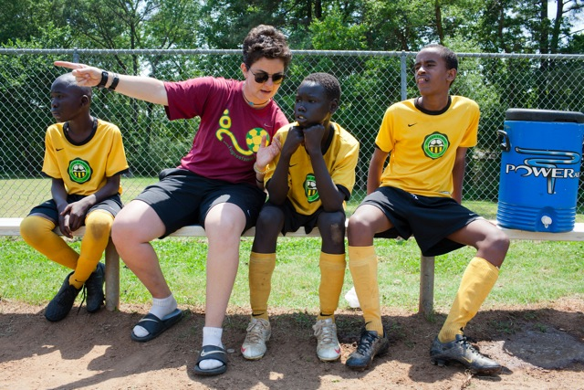
Lending a hand to refugees in America

Slide 4

Shaping more than skateboards

Slide 5
Social responsibility
One has an obligation to act in ways that benefit, not detract from, the welfare of society & its members.

Slide 6
Identify & describe examples in your own life, on campus, in the news, etc. that reflect actions of social responsibility.
Share your personal experience in being socially responsible, and what motivates you to be socially responsible.
What is the value of social responsibility to a community? To your own development?

Slide 7
What is Service-learning?
Experiential Education
Real learning & a real benefit to the community
Merging of direct experience with the learning environment
Intentional application of classroom learning
Need-Based
Meets a human and community need
Opportunity for personal development
Reflective
Evaluate, interpret & analyze
Further understand course content
Enhanced sense of civic responsibility

Slide 8

Examples of Reflective Discussion Questions
Beginning of the semester
What is the identified problem/community need?
Why are you needed?
What fear, if any, do you have about working in the community?
What do you hope to gain from this experience?
During the semester
What did you observe?
What has worked? What hasn't?
Is there something more you could do to contribute to the solution?
End of semester
What have you learned about yourself?
What have you learned about your community?
What values, opinions, beliefs have changed?

Slide 9
Benefits of S-L
Citizenship Skills
Interpersonal Development
Social Responsibility
Commitment to Service
Communication Skills
Cultural/Racial Understanding
Leadership Skills

Slide 10

I’M LEARNING MORE ABOUT MYSELF.
I CAN USE THESE SKILLS IN THE REAL WORLD.
I CAN LEARN MORE ABOUT LINCOLN.
IT’S NICE DOING SOMETHING OTHER THAN MATH.
I’M PAYING TUITION
TO DO THIS?
I’M JUST TOO
BUSY

Slide 11
MAKE A CHOICE.
HAVE A PLAN.

Slide 12





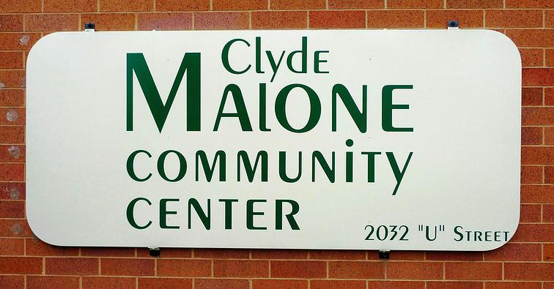



Where students have served…

Slide 13
Project Requirements
Service-Learning Inventory & 2 site contacts | Week 2 | 10
Service Learning Project Proposal | Week 5 | 25
Volunteer Schedule | Week 5 | 10
Experiential Learning Tab (ELT) | Week 5 | 25
Service Learning Project Agreement (Memorandum of Understanding) | Week 5 | 25
Service Learning Project Presentations 2 Presentations @ 20 pts. each | Week 5 & 9 | 40
Service Learning Project Critical Reflections 3 Reflections @ 10 pts. each | Week 9, 13, 17 | 30
ELT Evaluation | Week 17 | 25
Service Project Attendance | Ongoing | 100
20 hours spread throughout the semester. ~ 2-4 hours per week.
Service should begin no later than week #6.

Slide 14
You will fail the course if …
You do not complete 20 hours of volunteer service.
You do not create & submit the Experiential Learning Tab (ELT), and
You do not maintain your hours in the ELT.

Slide 15
Today’s Objectives
Define Service-Learning
Understand the purpose of S-L & project requirements
Identify S-L project outcomes
Have the tools to select a S-L project site

Slide 16
What’s next…
Lab Week 2
DUE: Service-Learning Inventory & 2 site contacts from S-L directory.
READ Textbook: Chapter 18 Servant Leadership
ACTIVITY: Immediate Feedback Form *In class activity
Lecture January 27
DUE: Quiz #2
READ Textbook: Chapter 2 Active Listening
WATCH Video: http://www.ted.com/playlists/92/listen_up
ON THE HORIZON…
Make initial contact with site supervisor of S-L site by Week 3.

